Slide 1




Self-Inferencing Reﬂection
Resolution for Java
Yue Li, Tian Tan, Yulei Sui, Jingling Xue
Complier Research Group @ UNSW, Australia
July 30, 2014

Slide 2
Static analysis for OO in practice ?

Slide 3

Static analysis for OO in practice ?
re re re … reflection !
Notes:
I think all the researchers whose interest is static analysis for OO languages such as Java and C#, may suffer from this question a lot.
If our answer is NO, the main reason would be reflection which is a dynamic feature of OO that is very difficult to analyze statically.
Now let us take Java as the target OO language and see what is reflection and why it is difficult to analyze.

Slide 4
Class Person {
String name;
void setName(String nm) {…};
}
… …
Person p = new Person();
p.setName(“John”);

Slide 5

Class Person {
String name;
void setName(String nm) {…};
}
… …
Person p = new Person();
p.setName(“John”);

Slide 6
Class Person {
String name;
void setName(String nm) {…};
}
… …
Person p = new Person();
p.setName(“John”);

Slide 7
Class Person {
String name;
void setName(String nm) {…};
}
… …
Person p = new Person();
p.setName(“John”);
class
field
method

Slide 8
Class Person {
String name;
Metaobject !
void setName(String nm) {…};
Class
}
Method
… …
Field
Person p = new Person();
p.setName(“John”);
class
field
method

Slide 9
Class c = Class.forName(“Person”);
Method m = c.getMethod(“setName”, …);
Object p = c.newInstance();
m.invoke(p, “John”);
Class Person {
String name;
Metaobject !
void setName(String nm) {…};
Class
}
Method
… …
Field
Person p = new Person();
p.setName(“John”);
class
field
method

Slide 10
Class c = Class.forName(“Person”);
Method m = c.getMethod(“setName”, …);
Field f = c.getField(“name”);
Object p = c.newInstance();
m.invoke(p, “John”);
Class Person {
String name;
Metaobject !
void setName(String nm) {…};
Class
}
Method
… …
Field
Person p = new Person();
p.setName(“John”);
class
field
method

Slide 11
Class c = Class.forName(“Person”);
Method m = c.getMethod(“setName”, …);
Field f = c.getField(“name”);
Object p = c.newInstance();
m.invoke(p, “John”);
f.set(p, xx); / s = (String) f.get(p);
Class Person {
String name;
Metaobject !
void setName(String nm) {…};
Class
}
Method
… …
Field
Person p = new Person();
p.setName(“John”);
class
field
method

Slide 12
Class c = Class.forName(“Person”);
Method m = c.getMethod(“setName”, …);
Field f = c.getField(“name”);
Runtime
Object p = c.newInstance();
m.invoke(p, “John”);
f.set(p, xx); / s = (String) f.get(p);
Class Person {
String name;
Metaobject !
void setName(String nm) {…};
Class
}
Method
Compile Time
… …
Field
Person p = new Person();
p.setName(“John”);
class
field
method

Slide 13
Class c = Class.forName(cName);
Bug Detection
Method m = c.getMethod(mName, …);
A a = new A();
Call graph edge
m.invoke(a, …);
method 1
method 3
method 2
B b = new B();
Field f = c.getField(“fld”);
Bug
a.fld = b;
f.set(a, a); // a.fld = a
B b2 = (B) a.fld;
Not Safe
Optimization

Slide 14
How existing work handle reflection ?

Slide 15
How existing work handle reflection ?
Reflection Analysis for Java
(APLAS 2005)
Benjamin Livshits, John Whaley, and Monica S. Lam

Slide 16



How existing work handle reflection ?
Reflection Analysis for Java
(APLAS 2005)
Benjamin Livshits, John Whaley, and Monica S. Lam

Slide 17
How existing work handle reflection ?
Reflection Analysis for Java
(APLAS 2005)
Benjamin Livshits, John Whaley, and Monica S. Lam
Class c = Class.forName(“Person”);
Method m = c.getMethod(“setName”, …);
Field f = c.getField(“name”);
Analyzing the string values of the arguments !

Slide 18
How existing work handle reflection ?
Reflection Analysis for Java
(APLAS 2005)
Benjamin Livshits, John Whaley, and Monica S. Lam
Configuration Files
Class c = Class.forName(“Person”);
Method m = c.getMethod(“setName”, …);
Field f = c.getField(“name”);
Analyzing the string values of the arguments !

Slide 19
How existing work handle reflection ?
Reflection Analysis for Java
(APLAS 2005)
Benjamin Livshits, John Whaley, and Monica S. Lam
Configuration Files
Class c = Class.forName(“Person”);
Command Lines
Method m = c.getMethod(“setName”, …);
Field f = c.getField(“name”);
Analyzing the string values of the arguments !

Slide 20
How existing work handle reflection ?
Reflection Analysis for Java
(APLAS 2005)
Benjamin Livshits, John Whaley, and Monica S. Lam
Configuration Files
Class c = Class.forName(“Person”);
Command Lines
Method m = c.getMethod(“setName”, …);
Field f = c.getField(“name”);
Complicated String
Operations
Analyzing the string values of the arguments !
Notes:
Besides string analysis, what else can you do? It seems impossible.

Slide 21
How existing work handle reflection ?
Reflection Analysis for Java
(APLAS 2005)
Benjamin Livshits, John Whaley, and Monica S. Lam
Can we do better ?

Slide 22
GOAL:
Analyze reflection in a better way
Notes:
But when we take this problem seriously, we find it difficult to start.
What we know is forname, invoke, etc, the pieces info known from paper, code and internet.
In fact, we do not know what to analyze? And no one can tell us.

Slide 23
GOAL:
?
Analyze reflection in a better way

Slide 24
GOAL:
?
Analyze reflection in a better way
191 methods (Java Reflection API)

Slide 25
Three kinds of methods
Entry Methods
Member-introspecting Methods
Side-Effect Methods

Slide 26
Three kinds of methods
Entry Methods
Class c = Class.forName(“Person”);
Member-introspecting Methods
Side-Effect Methods

Slide 27
Three kinds of methods
Entry Methods
Class c = Class.forName(“Person”);
Member-introspecting Methods
Method m = c.getMethod(“setName”, …);
Field f = c.getField(“name”);
Side-Effect Methods

Slide 28
Three kinds of methods
Entry Methods
Class c = Class.forName(“Person”);
Member-introspecting Methods
Method m = c.getMethod(“setName”, …);
Field f = c.getField(“name”);
Side-Effect Methods
Object p = c.newInstance();
m.invoke(p, “John”);
f.set(p, xx); / s = (String) f.get(p);
Notes:
So many methods → empirical study, how they are used

Slide 29
Study

Slide 30
Empirical Study
DaCapo (2006-10-MR2)
javac (1.7.0)
Eclipse (4.2.2)
jEdit (5.1.0)
Tomcat (7.0.42)
Jetty (9.0.5)

Slide 31
Empirical Study
DaCapo (2006-10-MR2)
javac (1.7.0)
Side-Effect Methods
Eclipse (4.2.2)
jEdit (5.1.0)
Demand-driven
Tomcat (7.0.42)
Manually
Jetty (9.0.5)

Slide 32
Empirical Study
DaCapo (2006-10-MR2)
javac (1.7.0)
Side-Effect Methods
Eclipse (4.2.2)
jEdit (5.1.0)
Demand-driven
Tomcat (7.0.42)
Manually
Jetty (9.0.5)
Side-Effect callsites: 609
Member-Introspecting callsites: 304
Entry callsites: 501

Slide 33
Empirical Study
DaCapo (2006-10-MR2)
javac (1.7.0)
Side-Effect Methods
Eclipse (4.2.2)
Useful findings
jEdit (5.1.0)
Demand-driven
Tomcat (7.0.42)
Manually
Jetty (9.0.5)
Side-Effect callsites: 609
Member-Introspecting callsites: 304
Entry callsites: 501

Slide 34
Entry Methods

Slide 35
Side-Effect Methods

Slide 36
String Arguments

Slide 37
Self-Inferencing Property

Slide 38
Self-Inferencing Property
Class Person {
String name;
void setName(String nm) {…};
}
Person p = new Person();
Class c = Class.forName(“Person”);
Field f = c.getField(“name”);
String s = (String) f.get(p);
// s = p.f

Slide 39
Self-Inferencing Property
Class Person {
String name;
void setName(String nm) {…};
}
Person p = new Person();
Class c = Class.forName( ? );
Field f = c.getField(“name”);
String s = (String) f.get(p);
// s = p.f

Slide 40
Self-Inferencing Property
Class Person {
String name;
void setName(String nm) {…};
}
Person p = new Person();
Class c = Class.forName( ? );
Field f = c.getField(”name”);
String s = (String) f.get(p);
// s = p.f

Slide 41
Self-Inferencing Property
Class Person {
String name;
void setName(String nm) {…};
}
Person p = new Person();
Class c = Class.forName( ? );
Field f = c.getField(”name”);
String s = (String) f.get(p);
// s = p.f

Slide 42
Self-Inferencing Property
Class Person {
String name;
void setName(String nm) {…};
}
Person p = new Person();
Class c = Class.forName(“Person”);
Field f = c.getField( ? );
String s = (String) f.get(p);
// s = p.f

Slide 43
Self-Inferencing Property
Class Person {
String name;
void setName(String nm) {…};
}
Person p = new Person();
Class c = Class.forName(“Person”);
Field f = c.getField( ? );
String s = (String) f.get(p);
// s = p.f

Slide 44
Self-Inferencing Property
Class Person {
String name;
void setName(String nm) {…};
}
Person p = new Person();
Class c = Class.forName(“Person”);
Field f = c.getField( ? );
String s = (String) f.get(p);
// s = p.f

Slide 45
ELF
Self-inferencing Reflection Resolution for Java

Slide 46
Intuition
When string arguments cannot be resolved statically
Infer the reflective targets at their usage points

Slide 47
ELF

Slide 48
ELF

Slide 49
ELF
class name known

Slide 50
ELF
class name known

Slide 51
ELF
class name known

Slide 52
ELF
class name known
method/field name known

Slide 53
ELF
class name known
method/field name known

Slide 54

ELF
class name unknown
method/field name known

Slide 55
ELF
class name unknown
method/field name known

Slide 56
ELF
class name known
method/field name unknown

Slide 57
ELF
class name known
method/field name unknown

Slide 58
ELF: Principle

Slide 59
ELF: Principle
(1)

Slide 60
ELF: Principle
(1)
(2)
→

Slide 61
Example

Slide 62
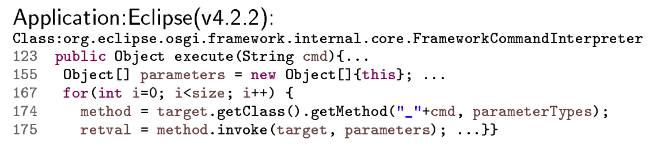
Example

Slide 63
Example

Slide 64
Example

Slide 65
Example

Slide 66
Example

Slide 67
Example

Slide 68
Example

Slide 69
Example
ELF
50 targets
48!

Slide 70

ELF
207 rules
Most comprehensive in
handling reflection API
Open source
http://www.cse.unsw.edu.au/~corg/elf/

Slide 71
Evaluation
DOOP vs ELF

Slide 72

The number of resolved reflective callsites
Method:
invoke
Field:
get
Field:
set

Slide 73
Precision Comparison
DOOP & ELF unsound
DOOP
(class type)
ELF
(class type + method/field signature)
Callsites & targets
Recall (TamiFlex + DaCapo inputs)
For most targets

Slide 74

The number of resolved reflective targets
Method:
invoke
Field:
get
Field:
set
Notes:
For most cases

Slide 75
The number of resolved reflective targets
Method:
invoke
Field:
get
Field:
set
Notes:
For most cases

Slide 76
The number of resolved reflective targets
Method:
invoke
Field:
get
Class: org.eclipse.osgi.util.NLS
Field:
set
Two set() callsites
Initialize all non-final static fields in 4 classes
552 in total
Notes:
For most cases

Slide 77
The number of resolved reflective targets
Method:
invoke
Field:
get
Class: org.eclipse.osgi.util.NLS
Field:
set
Two set() callsites
Initialize all non-final static fields in 4 classes
552 in total
Notes:
For most cases

Slide 78
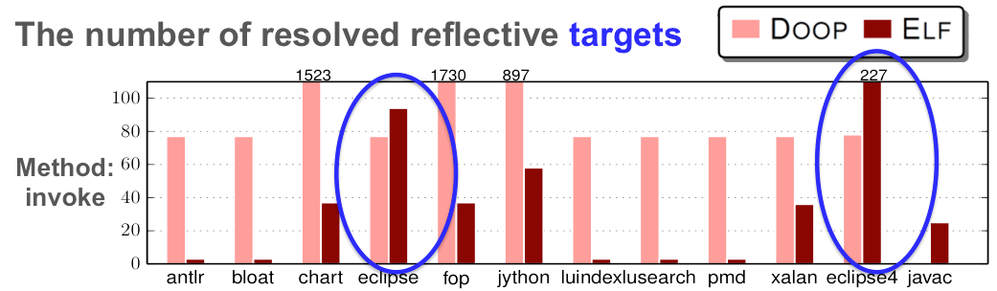
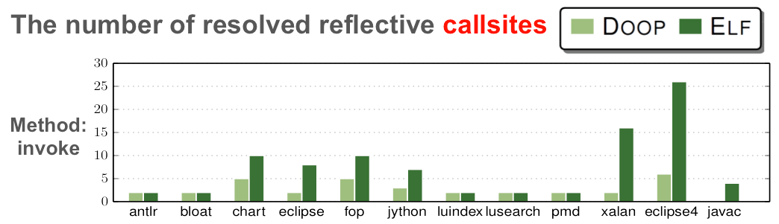
Notes:
For most cases

Slide 79
DOOP: 2 callsites
ELF: 8 callsites
DOOP: 6 callsites
ELF: 26 callsites
Notes:
For most cases

Slide 80
The invoke() case: 48 true targets
ELF resolves 50 at that callsite
48 x 2 = 96 targets
DOOP: 2 callsites
ELF: 8 callsites
DOOP: 6 callsites
ELF: 26 callsites
Notes:
For most cases

Slide 81
Recall Experiment
TAMIFLEX (ICSE 2011)
DaCapo Inputs: small, default and large
All true targets resolved by DOOP can be resolved by ELF except one special case

Slide 82
Recall Experiment
TAMIFLEX (ICSE 2011)
DaCapo Inputs: small, default and large
All true targets resolved by DOOP can be resolved by ELF except one special case
DOOP: spurious → true field target
in jython accidentally

Slide 83
Scalability
Comparing ELF and DOOP in term of analysis times (secs)
ELF: 1.9X slowdown on average with hsqldb disregarded

Slide 84
Conclusion
Study: useful findings on reflection usage
ELF: a self-inferencing resolution approach
An open-source implementation

Slide 85
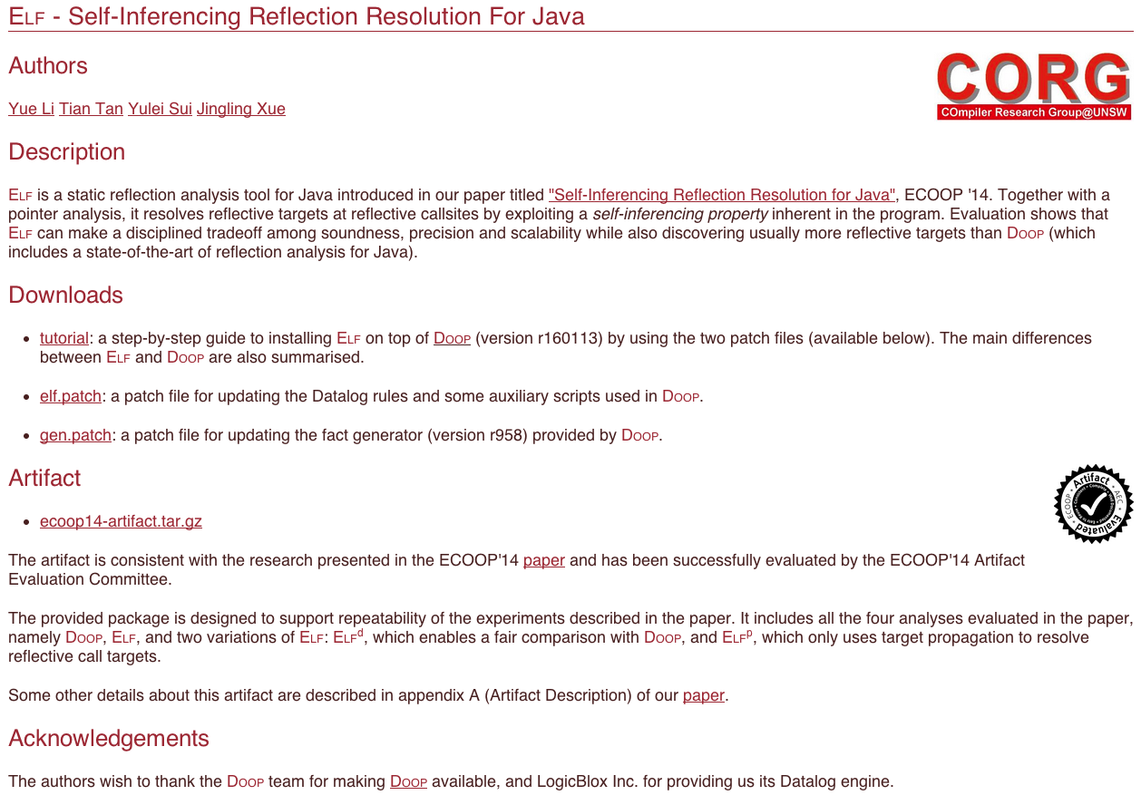

http://www.cse.unsw.edu.au/~corg/elf/
Static analysis for OO in practice ?
Self-Inferencing Property
Reflection

Slide 86
Conclusion
Study: useful findings on reflection usage
ELF: a self-inferencing resolution approach
An open-source implementation
Potential Impact
Reflection
Analysis
Many Popular Frameworks (e.g., Chord)
& Hundreds of Papers

Slide 87
Conclusion
Study: useful findings on reflection usage
ELF: a self-inferencing resolution approach
An open-source implementation
Potential Impact
Reflection
Analysis
ELF
Many Popular Frameworks (e.g., Chord)
& Hundreds of Papers

Slide 88
Conclusion
Study: useful findings on reflection usage
ELF: a self-inferencing resolution approach
An open-source implementation
Potential Impact
Reflection
Analysis
ELF
Nothing needs
to change
Many Popular Frameworks (e.g., Chord)
& Hundreds of Papers

Slide 89
Conclusion
Study: useful findings on reflection usage
ELF: a self-inferencing resolution approach
An open-source implementation
Potential Impact
Reflection
Analysis
ELF
More bugs, etc.
Nothing needs
to change
Many Popular Frameworks (e.g., Chord)
& Hundreds of Papers

Slide 90
Static analysis for OO in practice ?

Slide 91
Static analysis for OO in practice ?
Reflection
Notes:
Reflection is not mysterious anymore and It is time to pay attention on reflection to make static analysis for oo languages more practical,
rather than regarding it as an assumption in the paper any more.

Slide 92

Thank You
Yue Li
CORG @ UNSW, Australia
July 30, 2014

